Slide 1
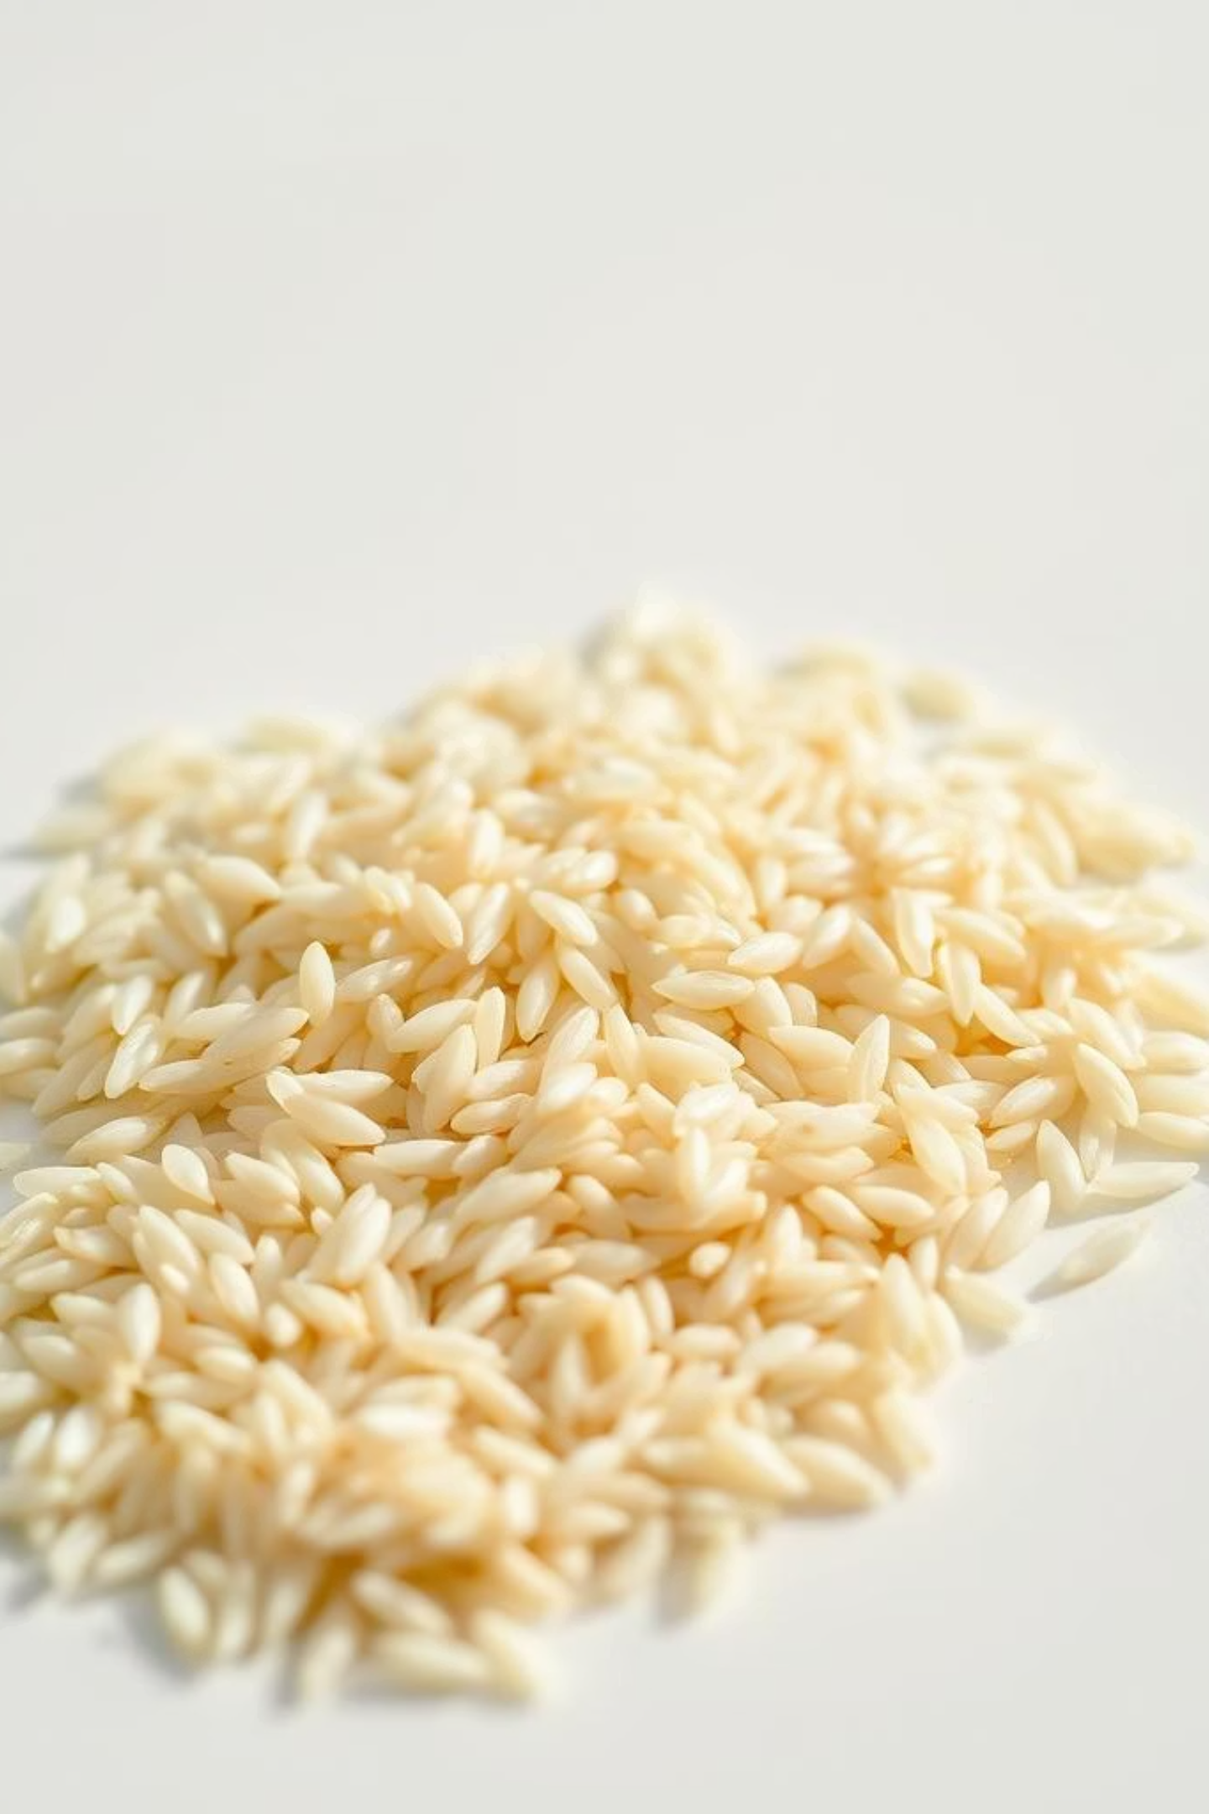
Grain Palette: Rice Type Classification Using Deep Learning
This presentation introduces 'Grain Palette', a project leveraging Convolutional Neural Networks (CNNs) and Transfer Learning (MobileNetV2) for the automated classification of five distinct rice varieties. We will cover the technical methodology, deployment as a user-friendly web application, and the implications for agricultural quality control.

Slide 2
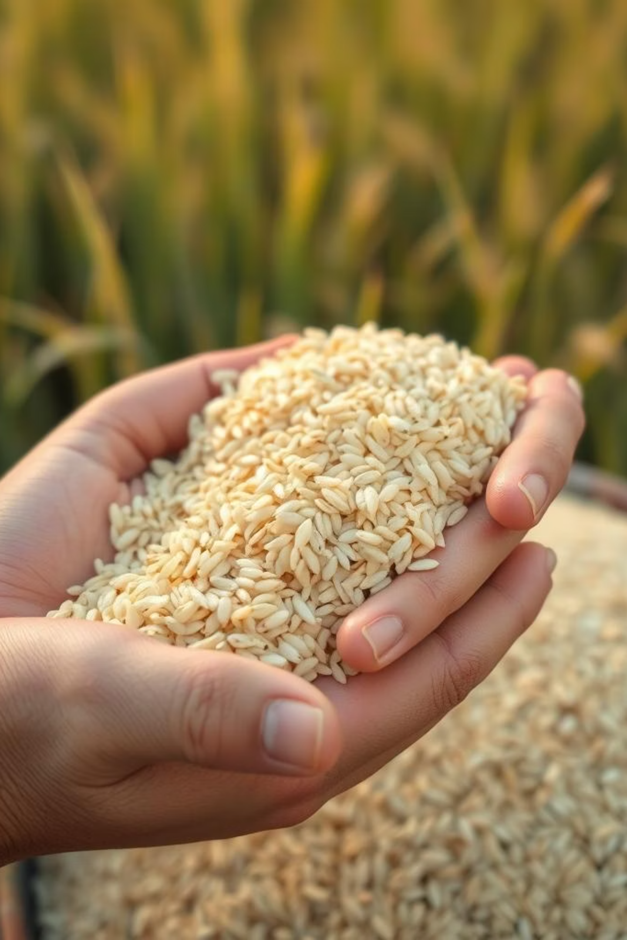
Introduction: The Imperative for Automated Rice Classification
As global population density continues to increase, the demand for rice escalates, underscoring the critical need for efficient quality control and precise varietal classification. Traditional manual inspection methods are not only time-consuming and labor-intensive but also prone to subjective interpretation, leading to inconsistencies.
An AI-driven system, such as 'Grain Palette', offers a scalable, objective, and significantly faster alternative, ensuring consistent quality and enhancing market value for producers and consumers alike.

Slide 3
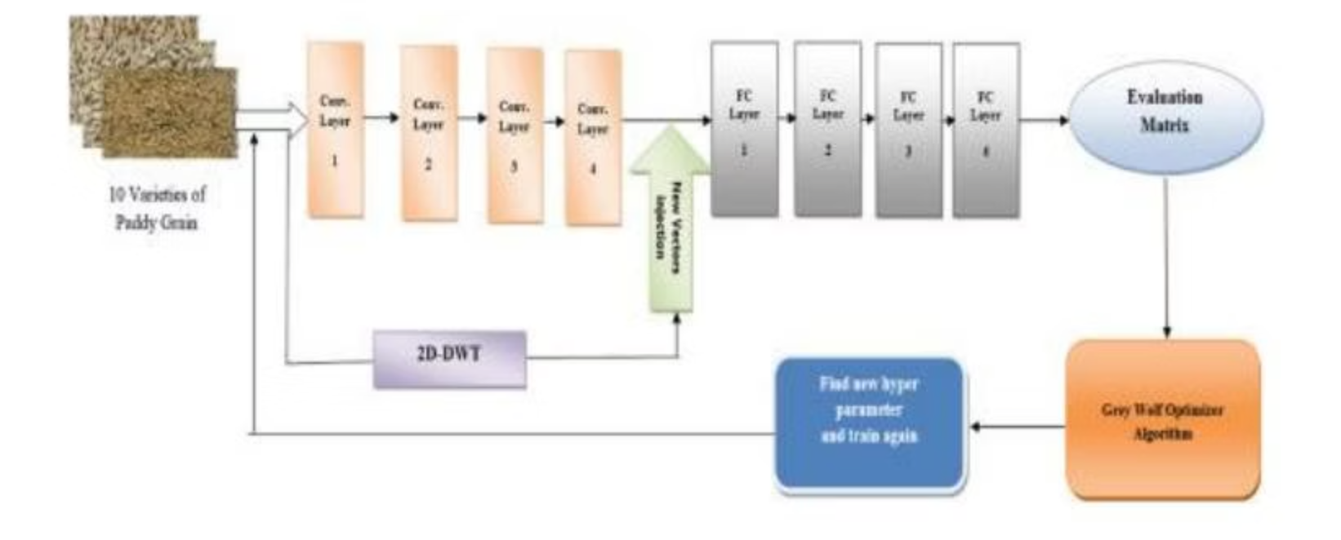
Core Techniques: Convolutional Neural Networks (CNNs)
Convolutional Neural Networks (CNNs) are a specialized class of deep learning models expertly designed for processing and interpreting visual data. Their architecture enables automatic learning of hierarchical spatial features from raw image inputs.
Convolutional Layers: Apply learnable filters to extract low-level features such as edges, textures, and gradients.
Activation Functions: Introduce non-linearity, allowing the model to capture complex, non-linear relationships within the data.
Pooling Layers: Reduce the spatial dimensions of feature maps, which enhances computational efficiency and generalizes the model's learned features.
Fully Connected Layers: Consolidate the extracted features to perform the final classification based on the learned patterns.

Slide 4
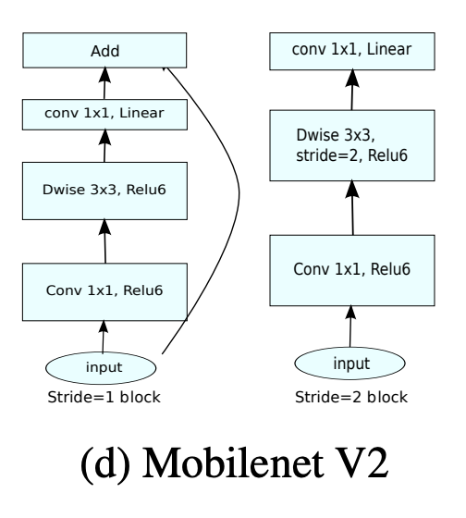
Advanced Techniques: MobileNetV2 and Transfer Learning
MobileNetV2: Efficient Architecture
Transfer Learning: Expediting Model Development
Transfer learning is a powerful paradigm in deep learning where a pre-trained model, developed for a broad task (e.g., ImageNet classification), is fine-tuned for a related but specific new task. In 'Grain Palette', MobileNetV2, pre-trained on the extensive ImageNet dataset, serves as a robust feature extractor. By leveraging its pre-existing knowledge of visual patterns and adding a custom classification layer, we significantly reduce the need for large, domain-specific datasets and accelerate training times while boosting model accuracy.
MobileNetV2, developed by Google, is a highly efficient deep learning architecture optimized for mobile and embedded applications. It achieves high accuracy with significantly reduced computational cost through its innovative use of depthwise separable convolutions, which decompose standard convolutions into two distinct steps: depthwise and pointwise operations. This optimization drastically decreases model parameters and computational load, making it ideal for resource-constrained environments.

Slide 5

Software Frameworks: TensorFlow and Flask
TensorFlow: The Core Machine Learning Engine
Flask: Web Application Deployment
TensorFlow, an open-source deep learning framework from Google, is the backbone of 'Grain Palette'. It facilitates the construction, training, and deployment of our rice classification model. We utilize TensorFlow's extensive API for data preprocessing, defining the MobileNetV2-based architecture, compiling the model with appropriate optimizers and loss functions, and saving the trained model as rice.h5. Its compatibility with both CPUs and GPUs ensures efficient training and seamless integration into web applications.
Flask, a lightweight Python web framework, is instrumental in deploying the 'Grain Palette' as a user-friendly web application. It handles routing, form submissions, and template rendering, allowing users to upload rice images for immediate classification. The backend processes the uploaded image, passes it to the pre-trained MobileNetV2 model, and displays the predicted rice variety. Flask's flexibility and simplicity make it an ideal choice for quickly developing interactive machine learning applications.

Slide 6
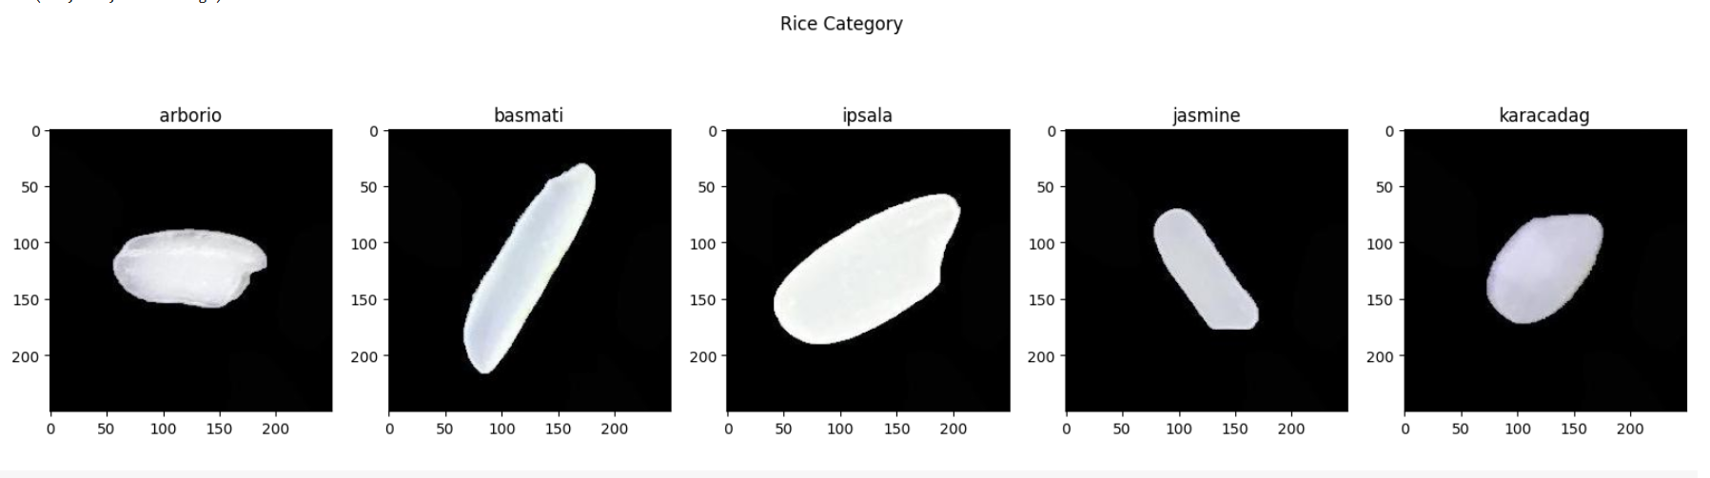
Dataset and Model Architecture
Dataset Description
Model Architecture
The 'Grain Palette' project utilizes a comprehensive dataset comprising 55 unique images for each of the five rice varieties: Arborio, Basmati, Ipsala, Jasmine, and Karacadag. Each variety includes 150 individual samples. These images capture both morphological (size, shape) and color-based features crucial for classification. Prior to model training, all images were consistently resized to 224x224 pixels and normalized to ensure optimal compatibility and performance with the neural network architecture.
The classification model leverages MobileNetV2 as a robust pre-trained backbone for transfer learning. This architecture is augmented with a specific sequence of layers designed for efficient rice variety classification:
GlobalAveragePooling2D: This layer reduces the spatial dimensions of the feature maps, summarizing the information extracted by the MobileNetV2 base.
Dropout Layer: A dropout rate of 0.5 is applied to prevent overfitting by randomly deactivating a fraction of neurons during training, enhancing model generalization.
Dense Layer with 5 Softmax Outputs: This final fully connected layer contains five neurons, each corresponding to one of the rice varieties, with a softmax acativation function to produce probability distributions for classification.
The model was trained over 10 epochs using the Adam optimizer and Sparse Categorical Crossentropy loss function, selected for their effectiveness in multi-class classification tasks.

Slide 7
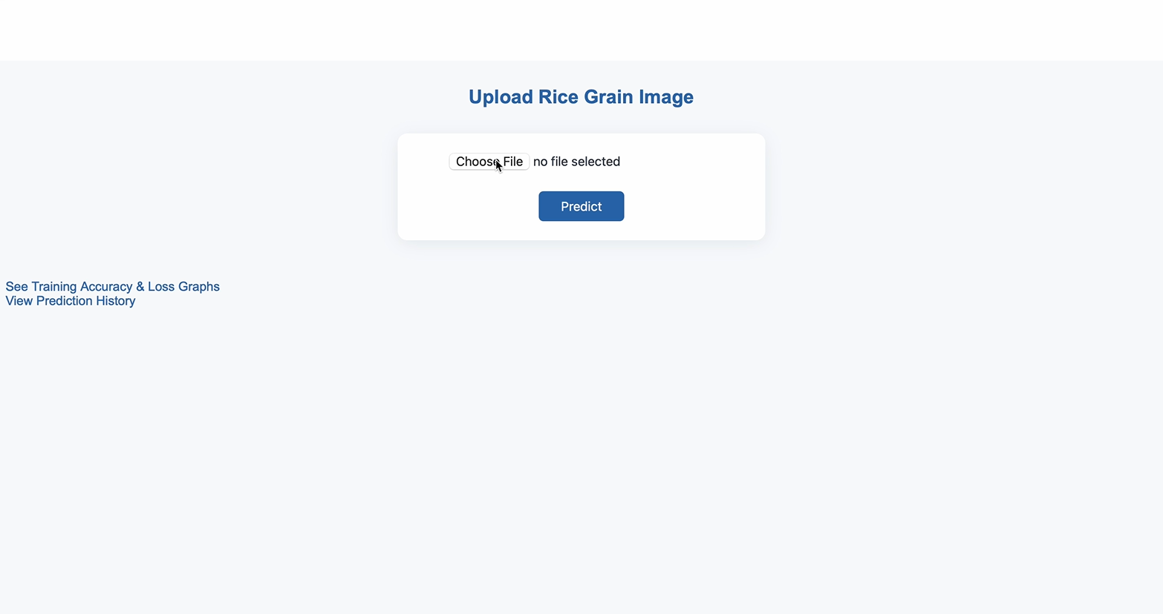
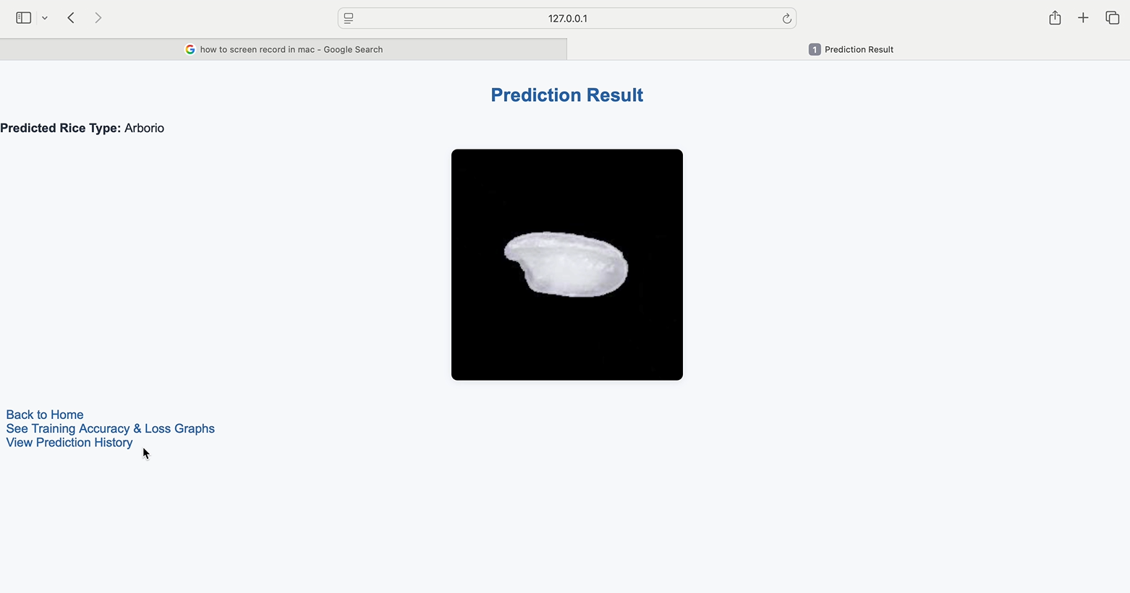
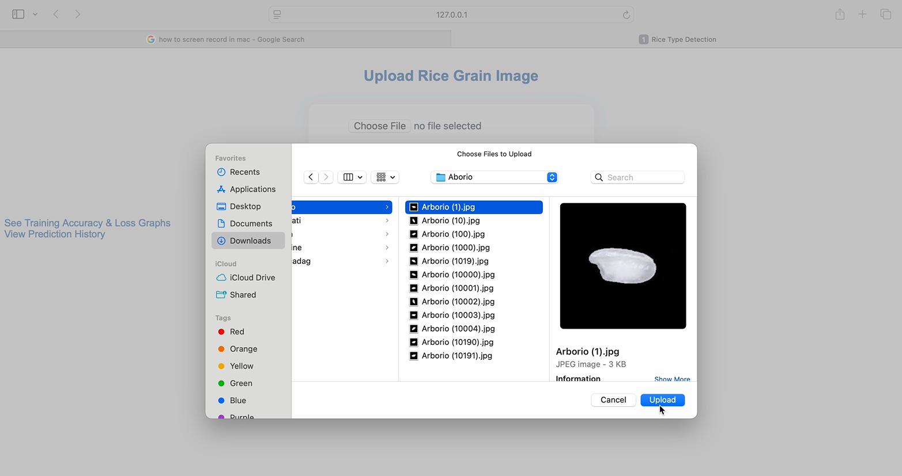
Web Application and Results
Grain Palette Web Application
Results Page Interface
The 'Grain Palette' web application is engineered with Flask on the backend and HTML/CSS for the frontend, providing an intuitive interface for rice grain classification. Users can upload images, which are then processed (resized, normalized) and fed into the trained MobileNetV2 model for real-time prediction. The results page dynamically displays the predicted rice variety along with the uploaded image and confidence scores.
The application also maintains a session-based prediction history and offers visual plots of training accuracy and loss, providing comprehensive insights into model performance. This design ensures the system is user-friendly for local deployment and scalable for cloud platforms like Heroku or AWS.

Slide 8
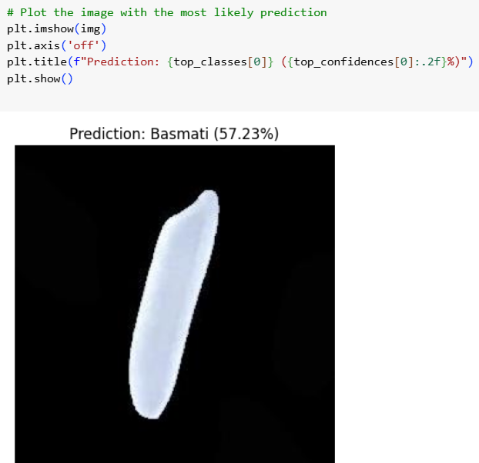
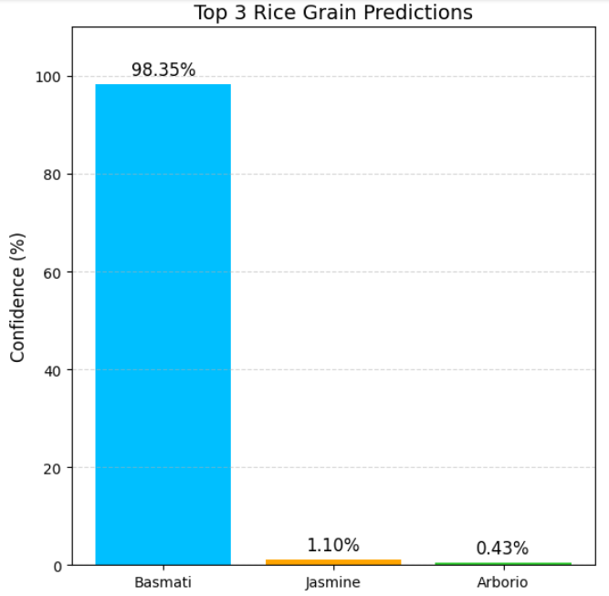
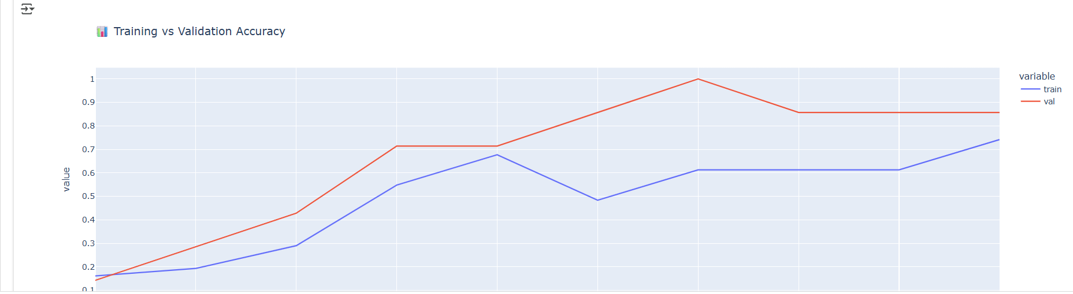
Evaluation, Conclusion, and Future Work
Results and Evaluation
Conclusion and Future Directions
The MobileNetV2-based rice classification model achieved approximately 60% accuracy on the validation dataset. While this performance indicates a functional proof-of-concept, there is considerable scope for improvement. Analysis of the training and validation accuracy/loss curves suggests the model is learning, but additional data augmentation, refined preprocessing techniques, or extensive fine-tuning of the MobileNetV2 layers could enhance accuracy significantly. Despite current limitations, the model's successful integration into a web application demonstrates the practical viability of deep learning in agricultural classification.
'Grain Palette' stands as a compelling example of how the synergy between deep learning and web technologies can effectively address real-world agricultural challenges. The project demonstrates the potential for automated, scalable, and objective rice variety classification.
Future enhancements could include:
Real-time Detection: Implementing features for live classification from video streams.
Mobile Deployment: Optimizing the model for deployment on edge devices for on-site analysis.
Expanded Varieties: Incorporating additional rice types and other grain varieties to broaden the system's utility.
Model Optimization: Exploring advanced training techniques, hyperparameter tuning, and alternative architectures to boost classification accuracy.
References
TensorFlow Documentation
Kaiming He et al. (ResNet Paper)
MobileNetV2: https://arxiv.org/abs/1801.04381
Flask Documentation
Murat Koilu Dataset Source

